Slide 1
Impact of Gym Accessibility on Training Preferences
Kassidy M, Freddy C, Sanmi L, Shriya Y

Slide 2
Introduction to our research topic
Project Description:
We aim to investigate how the relationship between gym accessibility factors may affect an individual’s training preferences.
Decided training categories
Gym/weight training
At-home training
Endurance/marathon training
Factors that got evaluated
Cost of gym memberships
Means of transportation
Income levels by state

Slide 3

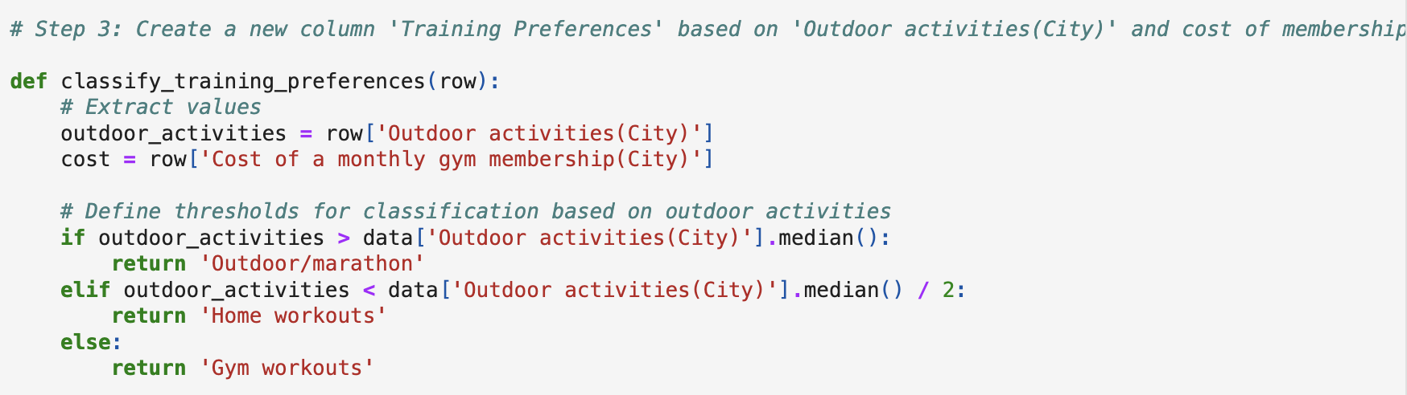
Training Preferences by Gym Membership Cost
Loading and Preparing Data: CSV data file from Kaggle.
The data set, Healthy Lifestyle Cities 2021, had 10 total columns. For my part of the project I only used 2 columns: “Membership Cost” and “Outdoor Activities”
Cleaned the membership cost column
I created a training preferences column based on the number of hours spent outdoors.

Slide 4
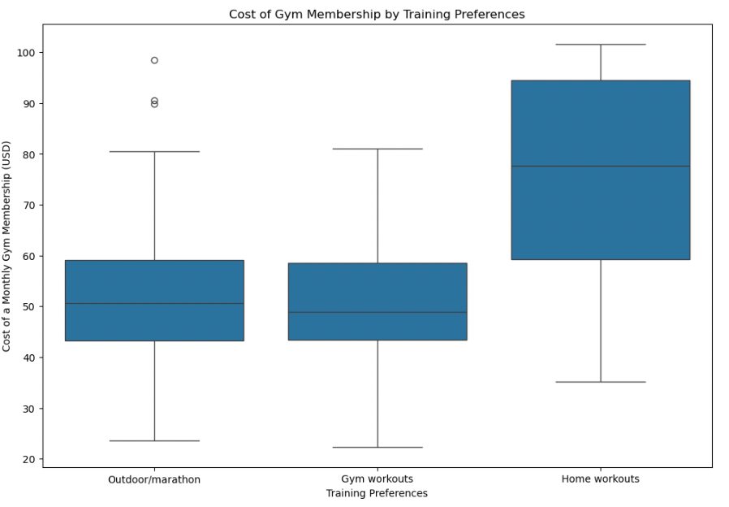
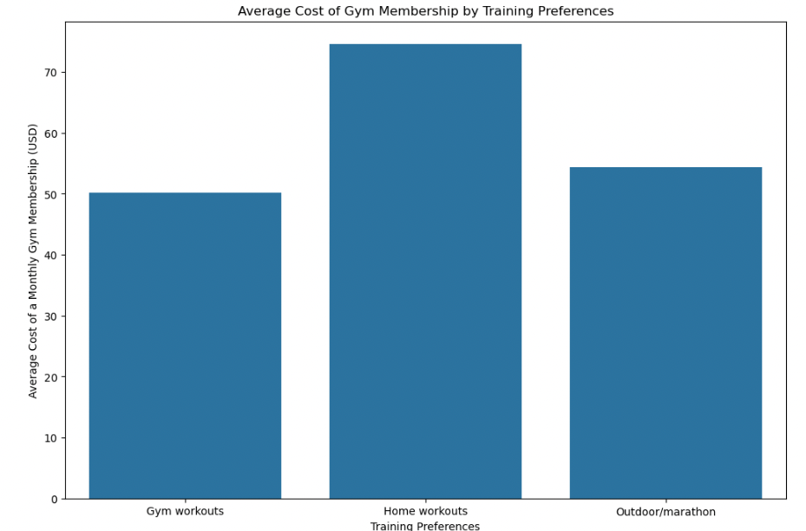
(Any graphs for Cost vs Training preferences)

Slide 5

ANOVA test
Interpretation
F-statistic: 3.8765
p-value: 0.0287
Conclusion
This indicates that you can reject the null hypothesis, suggesting that there is a statistically significant difference in gym membership costs among the different training preference groups (Gym workouts, Outdoor/marathon, Home workouts)

Slide 6
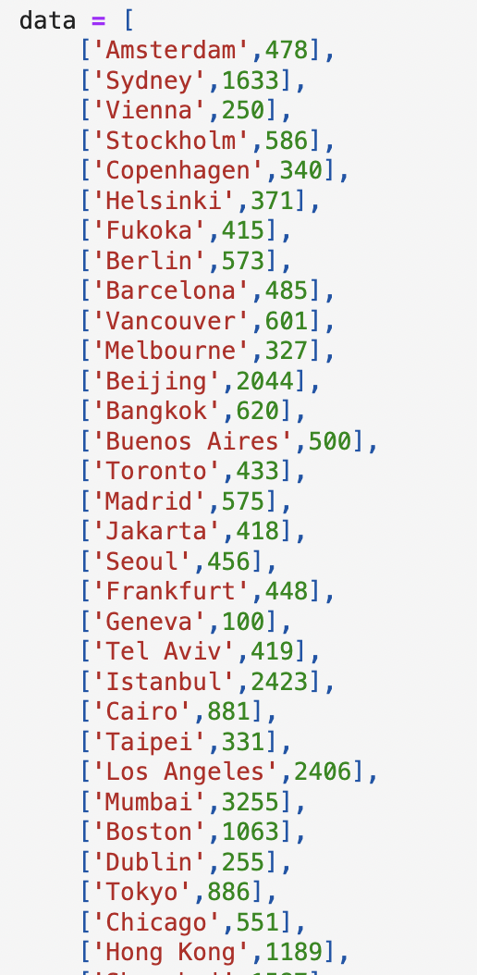
Location
Collected data for each city
Set up a data frame showing each city and number of gym locations per city.
Using prior code to calculate
the training preferences
Merged data sets

Slide 7
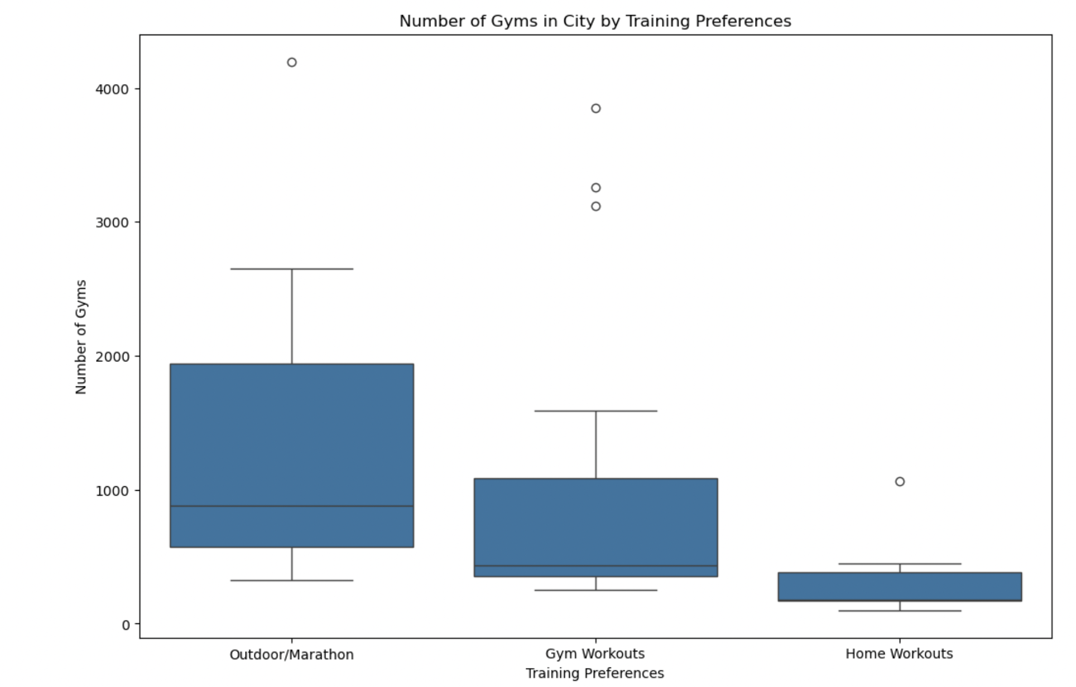
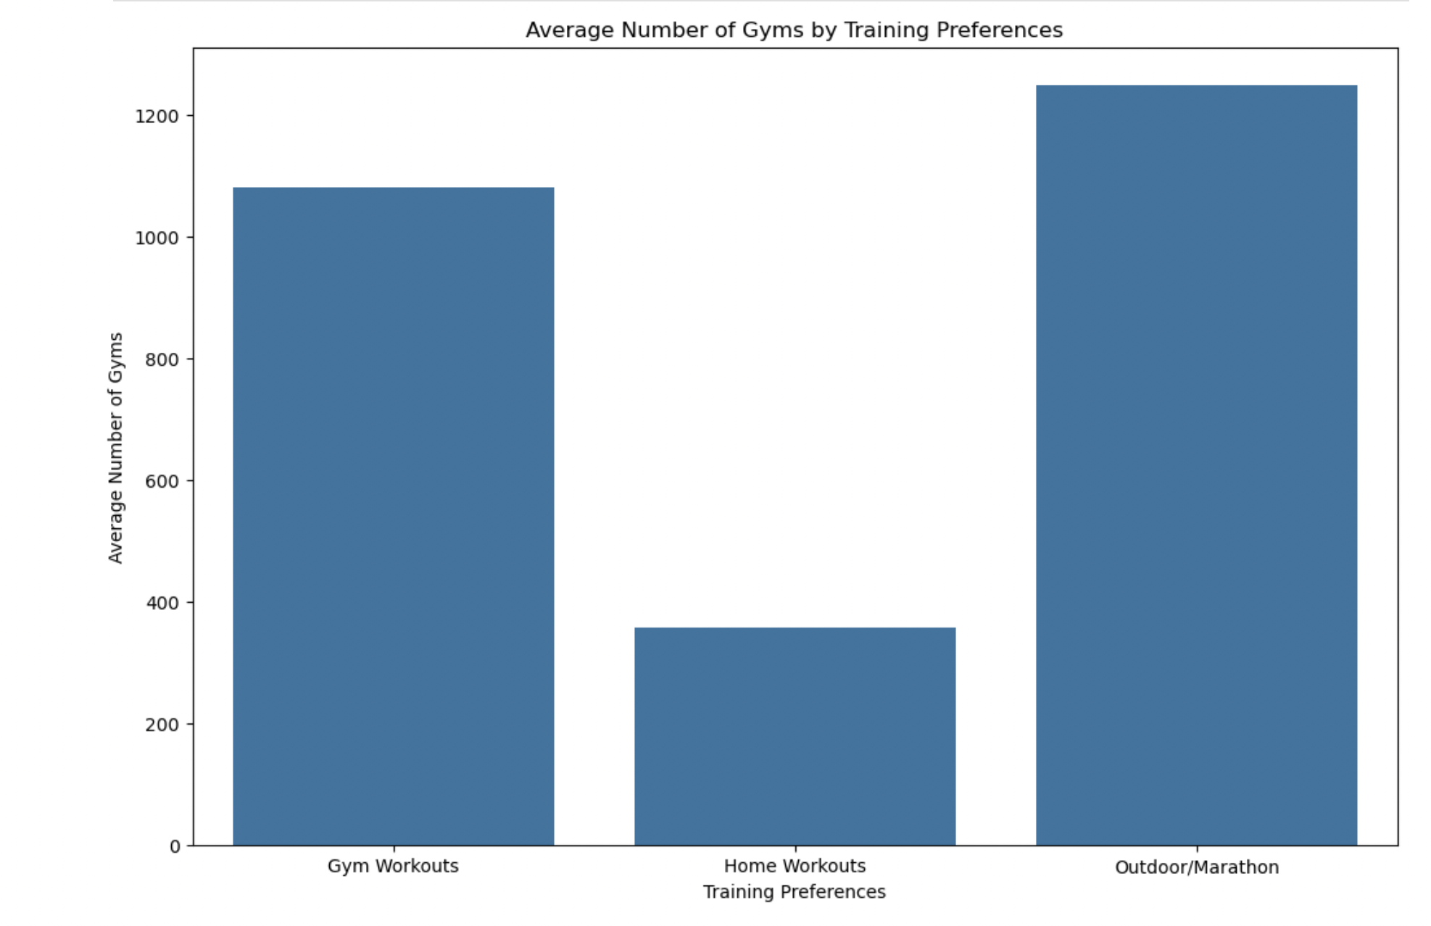
VISUAL REPRESENTATION

Slide 8
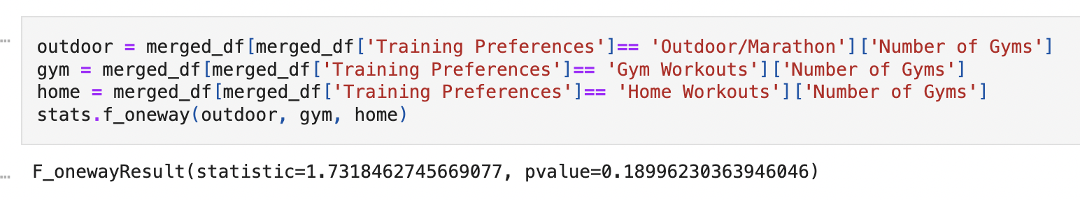
ANOVA TEST
Interpretation :
F-Statistic: 1.731846
P-Value: 0.18996
Conclusion:
This indicates that you cannot reject the null hypothesis, suggesting that there is not a statistically significant difference in gym membership costs among the different training preference groups (Gym workouts, Outdoor/marathon, Home workouts)

Slide 9
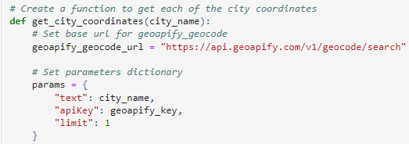
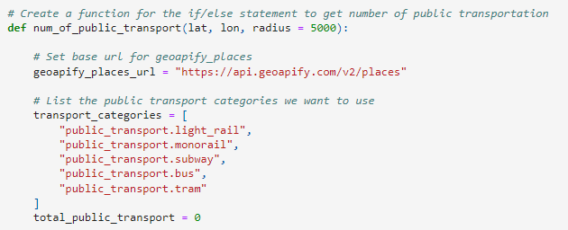
Transportation
Get City Coordinates using
Geoapify API Geocode
Calculate the number of public
transportation locations using
Geoapify API Places
Using prior code to calculate
the training preferences

Slide 10
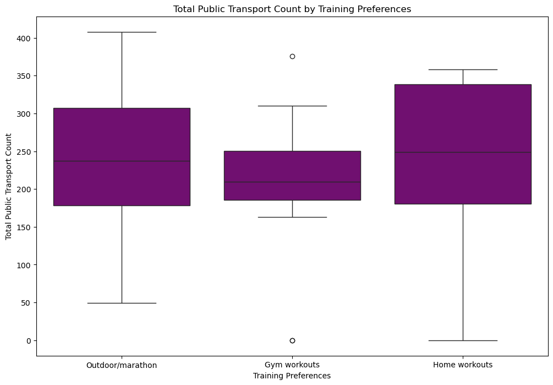
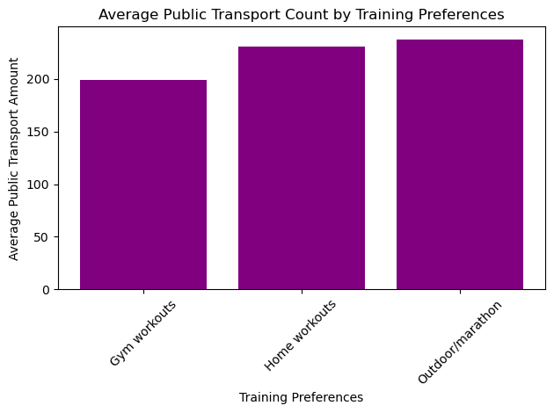
Visual representation(s)
Notes:
My box and whisker plots are all close together so there doesn’t seem to be any significant difference. My bar chart also doesn’t show any difference

Slide 11
Statistical Test
ANOVA Table
Why: We are testing against 3 categories: Gym, Home, and Outdoor Workouts
P-value: 0.6048
Conclusion: We cannot say that the amount of public transportation affects how people train because it is not statistically significant according to our P-value.

Slide 12
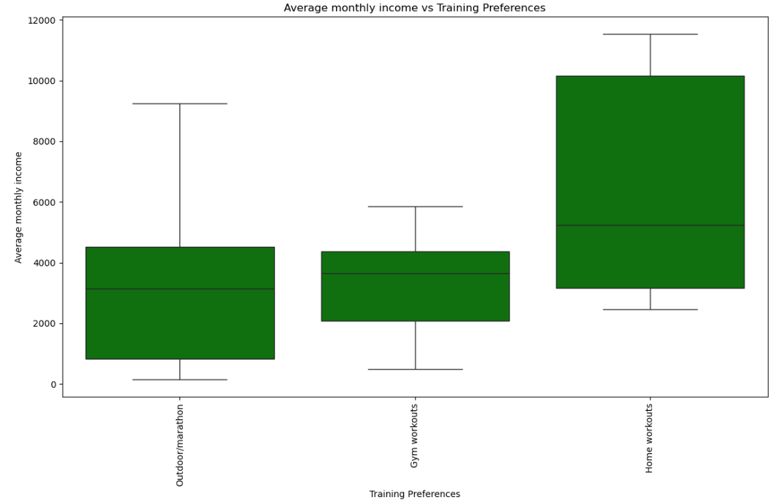
Training Preferences by Income Level

Slide 13
Statistical Test
F-statistic: 4.68
P-value = 0.01535

Slide 14
Conclusion
Analysis Tools:
Visualization: Employed bar graphs and box-and-whisker plots to depict relationships between factors and training preferences.
Statistical Test: Used an ANOVA test to determine the statistical significance of each factor.
Key Findings:
Non-Significant Factors: Number of gym locations and available transportation showed no statistical significance (p-value > .05).
Significant Factor: Membership cost (p-value = .0287) and income level (p-value = .01535) were statistically significant , influencing training method preference.
Conclusion: Membership cost significantly impacts training preferences in urban areas.

Slide 15
Credits
Healthy Lifestyle Cities Report 2021 (kaggle.com) for Costs and City Names
Geoapify API for Transportation
Google for Locations and Income

